Slide 1
Happy bobby clown school
Ami purohit
Kalpesh patel
Michael Lishaa
Denys Melnyk

Slide 2
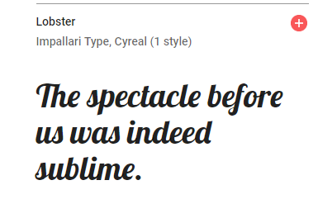
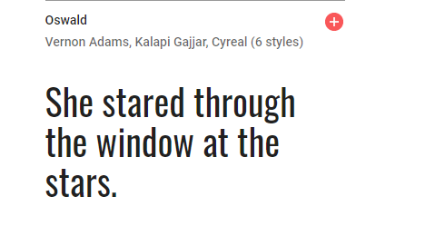
Font selection

Slide 3
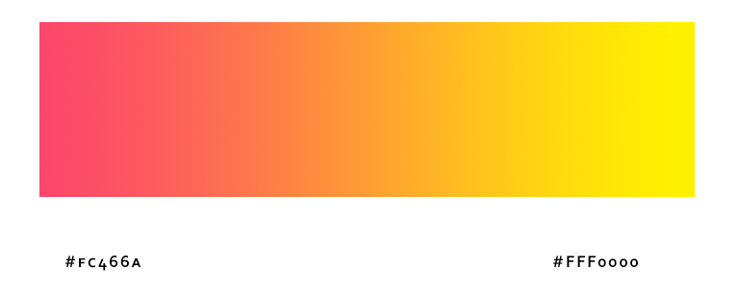
Color selection
Gradient:
Black:#000
white:#fff
color:#632c02

Slide 4
Client requirements
Client meeting notes done on August 18, 2019.
A website for school that is specialized in training for Clown careers.
website should be fun looking and bright colors.
Informative about school programs.
Should be usable on mobile devices as well as computer screen.

Slide 5
Team analysis
We decided to put first priority for Mobile devices and expand it to adapt computer screen.
We decided to use bootstrap and font awesome for our project.
After first draft we will present the project to client.

Slide 6
Thank you

